Slide 1
Objectives, methods, deliverables
Christopher I. Macintosh, PhD, RN
Notes:
Hello everyone
My name is Chris Macintosh. I help teach the capstone courses.
Today we’re talking about defining the methods and deliverables that you plan to use to meet your project objectives.
[Next slide]

Slide 2
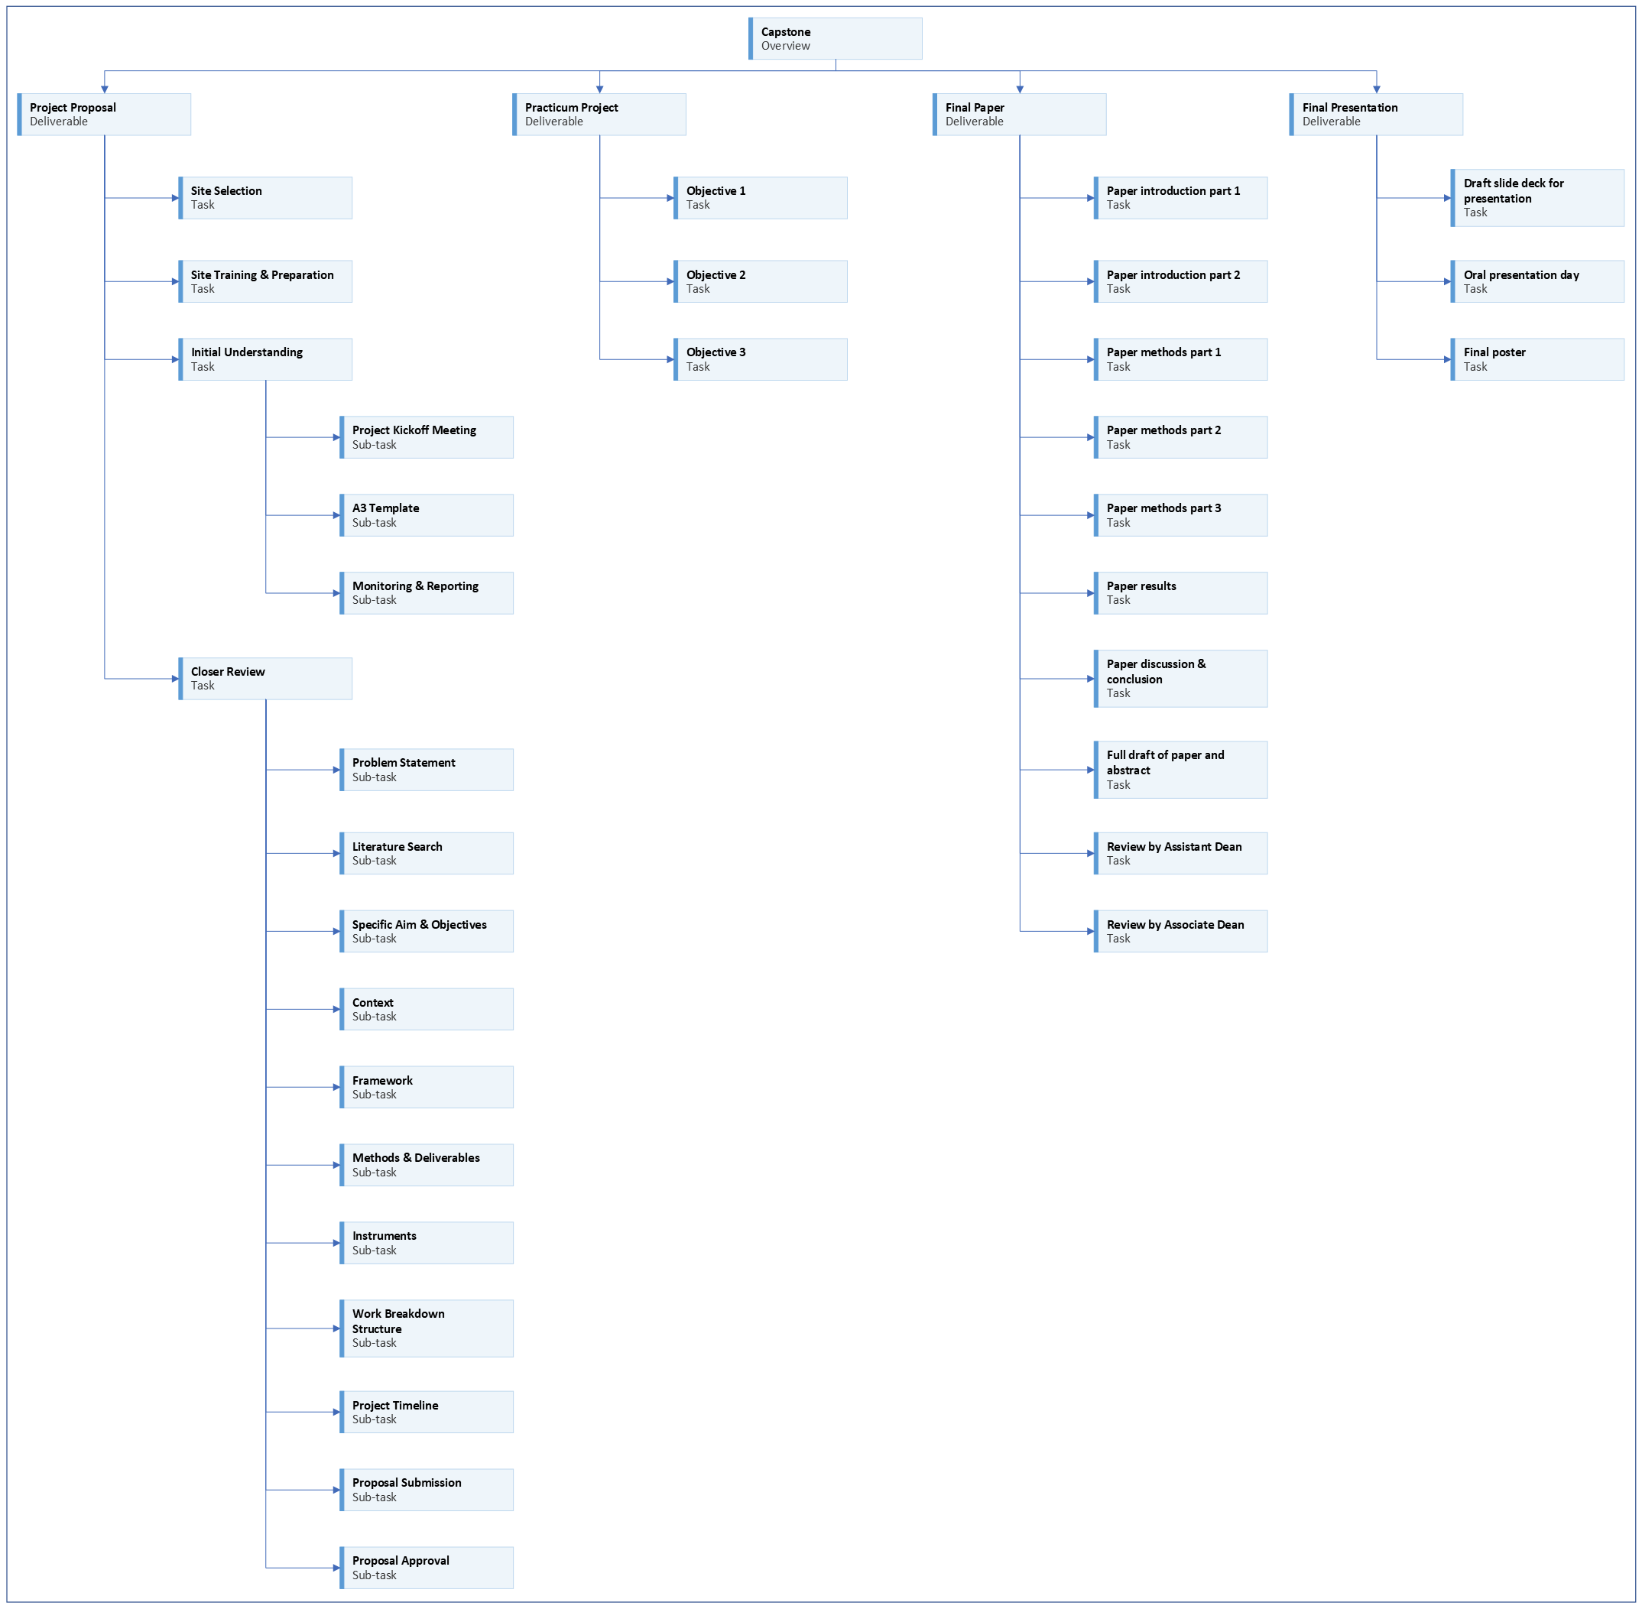
Notes:
[click]
We are working on the project proposal portion of your capstone experience.
[Next slide]

Slide 3
Notes:
Last time we talked about the methods and deliverables for your project objectives.
[Next slide]

Slide 4
Notes:
Today we will talk about the instruments you may use or create for your project.
[Next slide]

Slide 5

Address feedback
Notes:
You should be addressing any feedback on your assignments and pasting updated content in the appropriate sections.
[next slide]

Slide 6
Assess objective example
Objective | Method | Product/Outcome
Assess provider knowledge and interest in opioid prescribing changes and identify opioid prescribing rates. | Use an open-ended survey to assess providers’ knowledge, interest, and attitudes about opioid education. Use EHR reporting tool to get provider prescribing practices and rates. | Summary of common themes from the survey. Descriptive statistics of opioid prescribing rates.
Notes:
Last time we looked at this example that used a survey.
[next slide]

Slide 7
develop objective example
Objective | Method | Product/Outcome
Develop an opioid clinical practice guideline that is specific to the needs of the clinic. | Create the clinical practice guideline based on survey results and chart review. Create educational material about the CPG. | Clinical practice guideline PowerPoint presentation Printed reference material Electronic copy of reference material
Notes:
We also looked at this example that mentions creating the clinical practice guideline and educational material.
Read
[next slide]

Slide 8
evaluate objective example
Objective | Method | Product/Outcome
Evaluate the feasibility, usability, and satisfaction of the effectiveness of decreasing the frequency and dose of opioid prescribing. | Survey providers using a structured questionnaire regarding the feasibility, usability, and satisfaction with the CPG. Ask about barriers and facilitators to continued use of the CPG. Collect post-intervention EHR data regarding prescribing rates. | Descriptive statistics from survey data. Analysis of prescribing rate change statistics.
Notes:
The methods for this evaluation objective uses a structured questionnaire.
Read
[next slide]

Slide 9
Tools/instruments
Are you using established tools, or are you creating your own?
Does the tool have published evidence? (description, reliability, validity)
If you developed a survey or questionnaire, how did you verify it? (i.e., content experts)
How are you going to collect data? Will you need to set up a survey online using a tool like REDCap?
Notes:
Are you using any tools or instruments as part of your project?
[click]
Do they already exist, or do you need to create your own?
[click]
Is there any literature published about existing tools?
[click]
If you’re developing your own, how will you verify it is sound?
[click]
How are you going to collect data? Will you need to use a tool like REDCap?
[next slide]

Slide 10
analyses
What type of data do you intend to collect?
How will you analyze it?
Notes:
You should also think about how you will analyze any data you collect.
[click]
What type of data will each instrument or tool generate?
[click]
How do you intend to analyze each type of data?

Slide 11




assignment
Notes:
[click]
If you’re using any existing tools or instruments, you need to describe them and cite relevant literature.
[click]
If you’re creating any questionnaires or other artifacts, describe what it is and provide a rough outline.
At least create a placeholder table, figure, or appendix item that represents what you intend to create for your project.
For a survey you intend to create, you could create a table that lists potential questions.
[click]
List what type of data you expect to see from each instrument and how you intend to analyze it.
[next slide]

Slide 12




Writing tip
Notes:
I will reiterate the writing tips.
If you’re using any instruments like questionnaires or surveys, those will be described in the Measures section of your project manuscript.
[click]
The more writing you can do this semester; the easier next semester will be.
[click]
Eventually I will be looking for well-formed paragraphs with topic sentences and supporting statements.
[click]
One way to check for well-formed paragraphs is try reverse outlining.
After you write your paragraph, highlight your topic sentence.
(I usually like to use light-gray to highlight topic sentences.)
Then check to see if the supporting statements in the paragraph support the topic sentence.
If they don’t all seem to support the topic sentence, then you need to write a broader topic sentence or split the paragraph into different paragraphs with separate topics.
[next slide]

Slide 13

More to come . . .
Notes:
That’s all we’ll do in this video.
There is more to come.
[next slide]

Slide 14
References

